Slide 1

Price Optimization Analysis

Slide 2


A good deal is a fair price, found fast.
— Marketplace Motto

Slide 3


Workflow
02
Exploratory Data Analysis
01
Problem Statement
Analyse product data to uncover pricing patterns, discount trends, and product competitiveness.
Identify how sellers can price products competitively while maintaining profitability.
03
Modeling
Deployment
04
Deploy the best-performing model as a user-friendly web app for real-time price prediction.
Build and evaluate machine learning models to predict optimal product prices based on key features.

Slide 4
Project Collaboration
Project Authors:
Hafsa M. Aden
Ryan Karimi
Rose Muthini
Lewis Karanja
Harrison Karime
Elizabeth Ogutu
Collaboration & Workflow
Notion served as our central hub for organizing tasks. We used it to:
Share notes and useful links in one accessible space
Document meeting notes and decisions for easy reference. - Track deadlines and assigned responsibilities through task boards.
Enable real-time collaboration reducing miscommunication and delays.

Slide 5
Business Understanding
At what price should one sell a product to remain competitive while still making a profit?
Problem Statement
Pricing is one of the most critical decisions for any seller. While costs, margins, and supplier agreements guide internal pricing, what’s often missing is visibility into how competitors price similar products. Without this context, sellers face two key risks:
Overpricing → losing customers to cheaper alternatives
Under pricing → cutting into profits unnecessarily.
New sellers entering marketplaces often struggle with:
Price variability – Similar products can vary widely in price (e.g., KSh 499 vs KSh 8,900).
Discount strategy – Discounts strongly influence buyers, but the "sweet spot" is unclear.

Slide 6






Stakeholders
New Sellers
Marketplace (e.g., Jumia)
Business Development
Data-backed guidance on product selection & pricing.
Gains from onboarding more sellers and improving customer experience
Use insights to attract and support vendors.
Data Science Team
End Customers
Build models
Deliver insights
Fair prices
Wider variety

Slide 7




Project Objectives
Support sellers in setting competitive yet profitable prices.
Generate data-driven insights from marketplace listings.
Benchmark products against competitors for market awareness.

Slide 8









RAID Summary
R
A
I
D
Risks
Assumptions
Issues
Dependencies
Limited user feedback
few respondents to the questionnaire, reducing insight into real-world tool usability.
This project depends on several external factors:
Jumia
Hosting Platform(Render)
Tableau
Website Structure Changes
If Jumia changes its webpage layout, the scraper could break, halting data collection.
Internet Accessibility
Users (especially small business owners) have access to reliable internet to use the online tool.

Slide 9
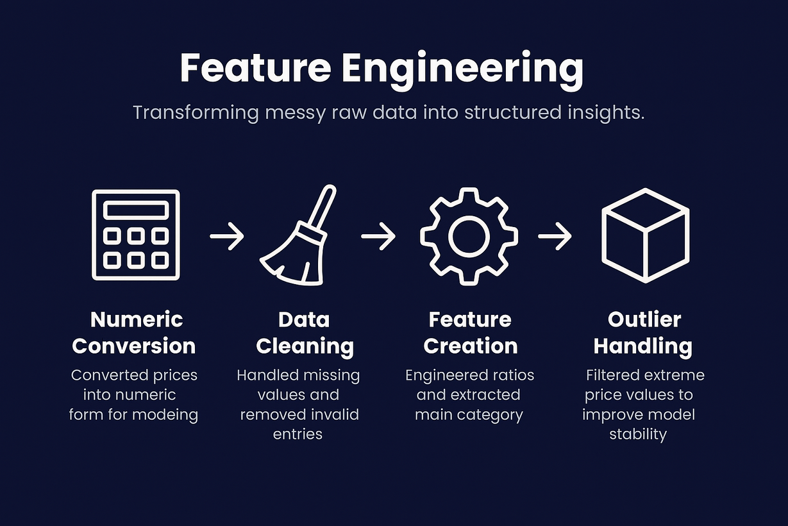
Data Understanding
Data Source
The dataset we worked with was scraped from Jumia.
It consist of 1,999 product listings with 13 features (columns) including:
current_price → Current product price.
original_price → Price before discount
discount → Discount percentage
main_category → Product category (electronics, fashion, etc.)
rating_number & verified_ratings → Customer satisfaction.
seller → Who is selling the item.
title → Product description.
Data Preparation
To prepare the dataset for analysis, we applied the following steps:
Removed duplicates: Many sellers list the same product multiple times.
Handled missing values: Some products lacked ratings or discounts. Strategies included:
Filling missing numeric values with averages.
Dropping irrelevant text-only columns when not useful for modeling.
Converted datatypes: Prices were stored as strings (KSh 499 → 499). Converted to integers.
Created new features:
discount_amount = original_price - current_price
discount_ratio = % discount offered

Slide 10
Exploratory Data Analysis (EDA)
We explored the dataset to understand patterns and relationships among products listed on Jumia Kenya, focusing on:
pricing behaviour
discount strategies
customer ratings, and category-level
competitiveness among products listed on Jumia Kenya.
The process involved four main steps:
data preparation
visual exploration
category-level analysis
feature engineering.
Price distribution:
To explore the relationship between original prices and discounts, a correlation analysis was conducted. The resulting correlation coefficient (0.08) indicates a very weak relationship between the two variables.
This suggests that both low-priced and high-priced products are equally likely to receive discounts, meaning discount rates are not strongly influenced by a product’s original price.

Slide 11
Exploratory Data Analysis (EDA)
Impact of discounts on product visibility.
To understand how discounts differ across product price tiers, products were grouped into four ranges:
Low (<1,000 KSh)
Mid (1,000–5,000 KSh)
High (5,000–10,000 KSh)
Very High (>10,000 KSh)
Discount by Price Range
Discounts remain consistent across all price ranges.
Whether products are low, mid, or high priced, they receive similar discount percentages, which is unexpected, as higher-priced items are often assumed to have larger discounts.
Discount by Product Category:
Gaming and Phones & Tablets show the highest average discounts (40%+) likely due to strong competition and frequent model updates.
Groceries have the lowest discounts, reflecting their smaller profit margins.
Fashion, Computing, and Health & Beauty maintain moderate discounts (20–40%), suggesting similar pricing strategies across these segments.
Summary:
Discount strategies are largely independent of product price, with consistent discount patterns across most price ranges and categories.
Gaming and Phones & Tablets receive the highest discounts likely due to competition and frequent model updates, while Groceries show the lowest.
Overall discounts do not appear strongly influenced by either product price or customer ratings.

Slide 12
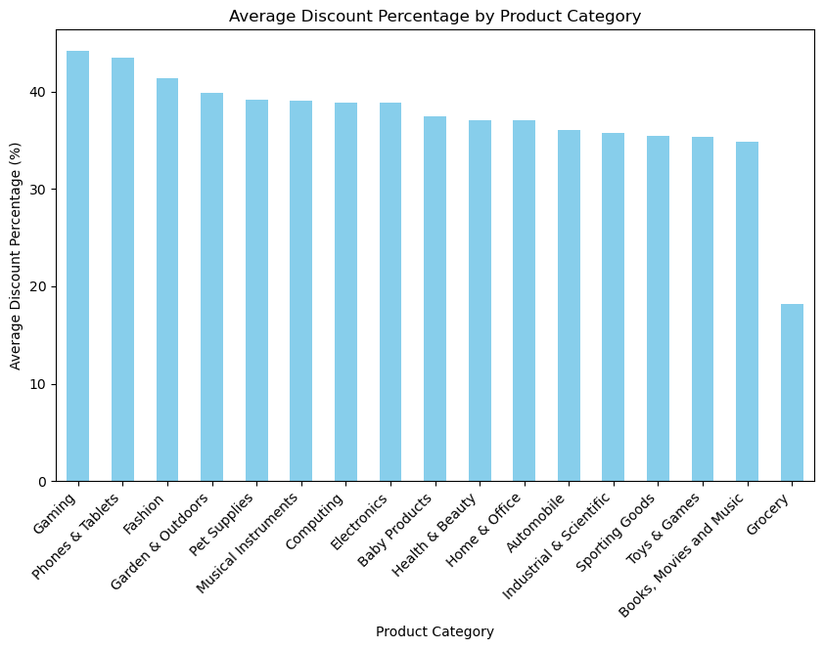
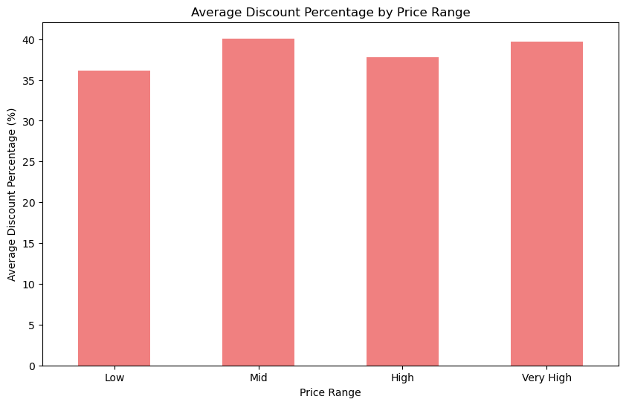
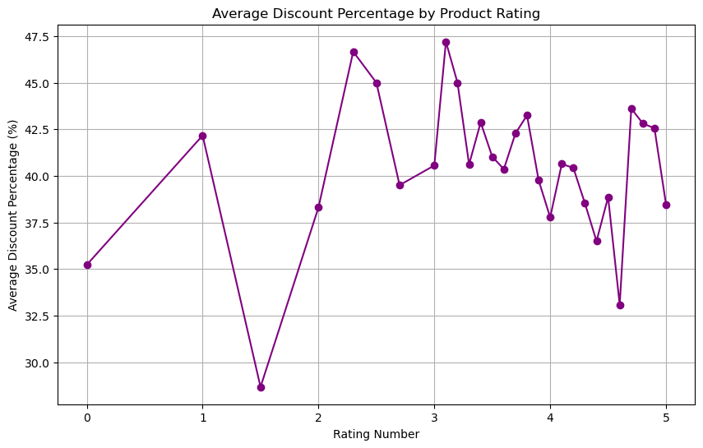
Exploratory Data Analysis (EDA)

Slide 13
Exploratory Data Analysis (EDA)
Product Competitiveness.
To identify the best-value or “deal” products, we assessed competitiveness within each category. A product was considered competitive if:
Its price was at or below the category’s median price, and
It had a rating of 4.0 or higher.
This method highlights products that are both affordable and well-rated, revealing which categories offer the best balance between price and customer satisfaction.
Main Category | Competitive (%)
Grocery | 47.06
Computing | 32.67
Sporting Goods | 31.25
Automobile | 29.73
Gaming | 28.57
Home & Office | 28.17
Health & Beauty | 26.51
Industrial & Scientific | 26.09
Baby Products | 23.08
Toys & Games | 19.51
Electronics | 18.54
Pet Supplies | 18.18
Garden & Outdoors | 16.28
Fashion | 14.25
Phones & Tablets | 13.64
Books, Movies and Music | 12.28
Musical Instruments | 0.00
key Insights:
Grocery items are the most competitive (47%), showing strong affordability and consistent ratings.
Computing, Sporting Goods, and Automobile categories follow closely (~30%).
Fashion, Phones & Tablets, and Books & Music have the lowest competitiveness, likely due to higher prices or lower ratings.
Overall, competitiveness varies widely across categories, showing that strong performance (good price + good ratings) is not uniform across product types.

Slide 14
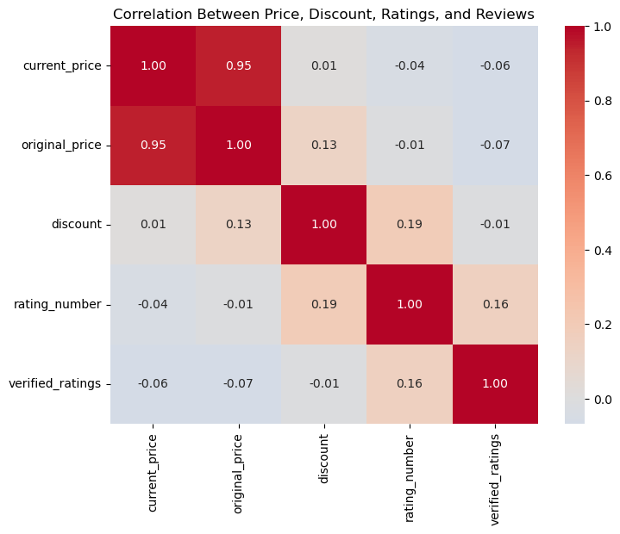
Exploratory Data Analysis (EDA)
Correlation
There is a strong positive correlation between current and original prices as current prices are derived from discounts.
Discounts shows weak influence on price, suggesting they serve more as marketing tools than true price drivers.
There’s no clear link between price and ratings, indicating that expensive products don’t necessarily receive better reviews.
While discounted products may attract slightly more ratings, the effect is minimal. As expected, products with more reviews tend to have slightly higher average ratings.

Slide 15





Modeling
Objective :
Build a reliable model that predicts fair, competitive prices while adapting to category trends.
Data Preparation
Feature Engineering
Test Multiple Models
Model Optimization & Evaluation
Clean prices and categories
Handling missing values and outliers
Compute median price per category
Logistic Regression K-Nearest Neighbours (KNN) Random Forest, and Neural Network
Neural Networks/KNN
Compare accuracy, precision, recall
Select best-performing model for deployment

Slide 16
Modelling
Data Source
Before building predictive models, the data was cleaned and pre-processed. Missing values were imputed, categorical variables were encoded, and numerical features were scaled to ensure consistency and improve model performance. The dataset was then split into training (80%) and testing (20%) subsets to evaluate how well each model generalizes to unseen data.
Models Tested
Several regression models were developed to predict the target variable based on product and pricing features:
Linear Regression served as a baseline for performance comparison.
K-Nearest Neighbours (KNN) Regressor captured local relationships in the data.
Decision Tree Regressor modelled non-linear patterns and feature interactions.
Random Forest Regressor leveraged multiple decision trees for better generalization.
Neural Network (MLP Regressor) tested for its ability to model complex, non-linear relationships.
Pipeline & Training
All models were trained using a consistent preprocessing pipeline built with Column Transformer and Pipeline, ensuring reproducibility and efficient feature handling.
Model Performance
Initial model results showed the following trends:
Linear Regression performed strongly, achieving an R² of 0.96, indicating a solid linear fit.
KNN and Decision Tree achieved R² scores of 0.91 and 0.88 respectively, suggesting some overfitting or sensitivity to data structure.
Neural Network showed moderate performance (R² of 0.87) but required longer training and did not converge fully.
Random Forest delivered a high R² of 0.94, significantly reducing error and improving predictive stability.

Slide 17
Modelling
Model Optimization
To further improve accuracy, GridSearchCV was applied for hyperparameter tuning across three advanced models:
Ridge Regression
Lasso Regression
Random Forest Regressor
Each model was fine-tuned using 3-fold cross-validation to identify best performing parameters.
Model Selection
Model performance was compared using the following metrics:
Mean Absolute Error (MAE)
Mean Squared Error (MSE)
Root Mean Squared Error (RMSE)
R-squared (R²).
Interpretation:
The Random Forest Regressor emerged as the best-performing model achieving:
MAE: 285.90
MSE: 721,254
R²: 0.99
MAE measures the average difference between predicted and actual values (model’s predictions deviate by about 286 units on average).
The Mean Squared Error (MSE) penalizes larger errors more heavily, indicating overall low prediction errors.
R² = 0.99 means the model explains 99% of the variance in the target variable, making it the most accurate and robust choice for deployment.
Model | Mean Absolute Error (MAE) | Mean Squared Error (MSE) | Root Mean Squared Error (RMSE) | R-squared (R²)
Random Forest | 285.90 | 721,254 | 849.27 | 0.9923
Ridge Regression | 1001.57 | 3,691,000 | 1921.20 | 0.9606
Lasso Regression | 815.11 | 3,692,944 | 1921.70 | 0.9606

Slide 18
Deployment
The project was deployed as a Flask web app and hosted on Render.
For the Frontend, we created a simple site where people can explore the project. The site has different pages:
Home → welcoming page with project overview.
Data → a page describing the dataset used.
Dashboard → Interactive Tableau Dashboard.
Team → information about the contributors.
There’s also a prediction form where a user can enter product details and instantly see the predicted price.
The backend used Random Forest model that was trained on our dataset. The outcome is a live, user-friendly web app that makes predictions in real time.
🔗 The tool is live and accessed here. You can explore the tool, input a product name and view competitor based pricing insughts.
User Feedback
To gather user insights, we shared a short questionnaire with small business owners after they explored the deployed tool.
The goal was to understand:
Whether the tool is helpful for their pricing decisions
If it solves their challenge of knowing competitor prices
What improvements or extra features they would like
You can view or take the Feedback questionnaire here:

Slide 19

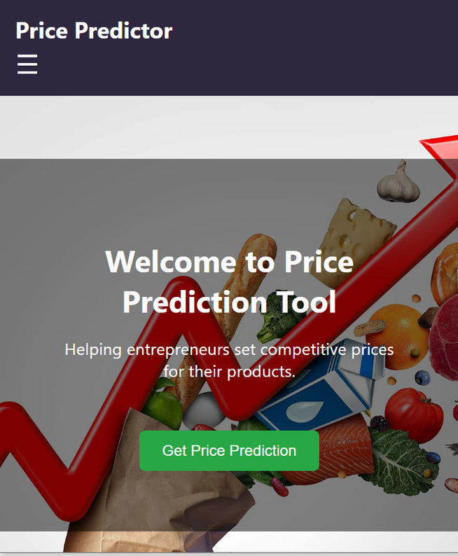
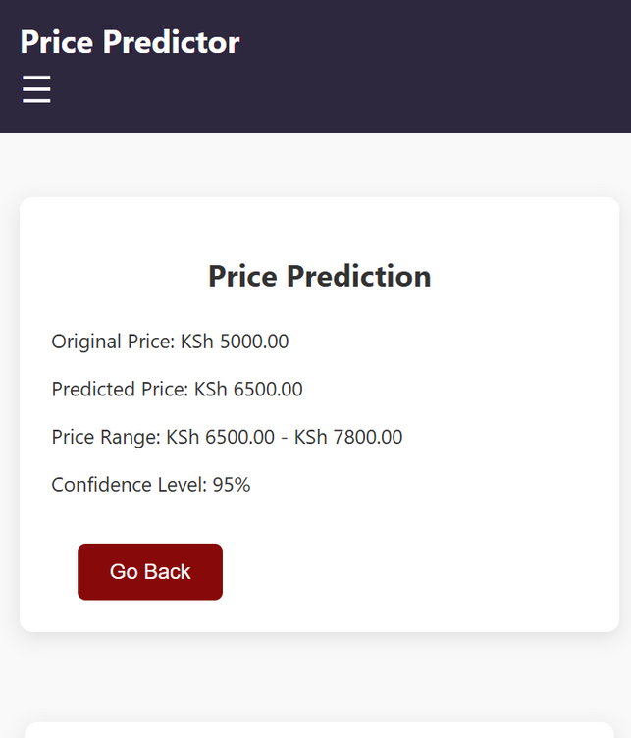
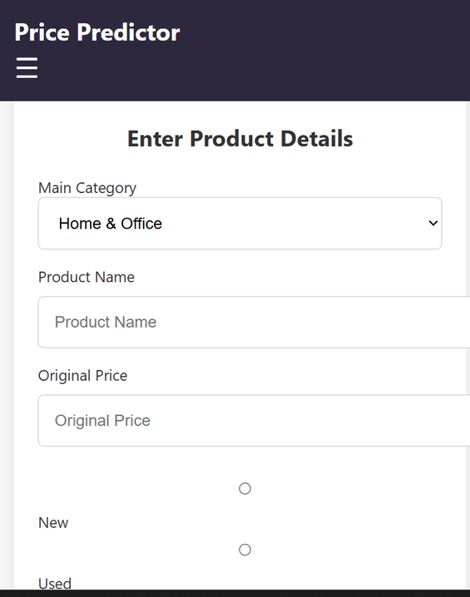

Deployment

Slide 20




Conclusions
This project demonstrates the end-to-end process from exploring the dataset and extracting insights, to training a robust predictive model, and finally transforming it into a live, user-friendly web app.
The result is a practical tool that allows anyone to input product details and instantly receive a predicted price, effectively bridging the gap between data and real-world application. It also shows how machine learning can support better decision-making in e-commerce, such as pricing strategies, deal evaluation, and customer awareness.

Slide 21


Thanks You
Presented by:
Harrison Kuria, Ryan Karimi, Elizabeth Ogutu, Hafsa Mohamed Aden, Rose Muthini, Lewis Mbugua
Other resourceful Links
Github
Tableau Dashboard

